Slide 1
Barclays Roundup Proposal for v2 – B2B pilot

Slide 2

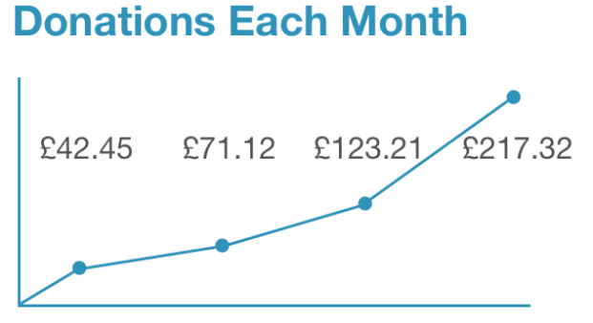
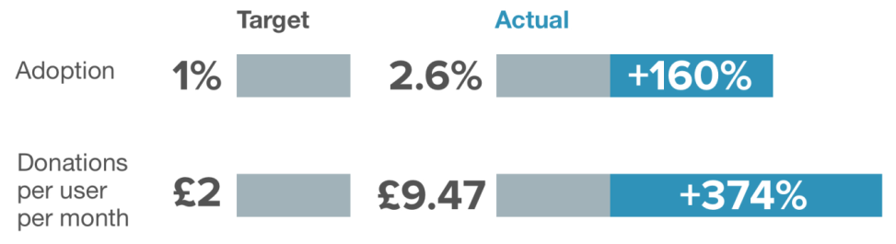
Barclays Roundup v1 : Pilot Review
The pilot of Barclays Roundup, funded by SIF, ran as internal, B2C six month pilot between January and June 2017. Email comms were sent to UK Citizenship Ambassadors at launch, supported by a Barclays Now story at the end of Q1.
Overview
v1.1
Launched January 17th
10 charities
6 banks included
v1.2
Updated March 31st
43 charities (plus portfolio option)
9 banks included
Feb Mar Apr May
The pilot was successful from a technical perspective; all bugs removed.
Initial metrics set were exceeded; both conversion and donations greater than expectations.
Enquiries from charities involved in pilot looking for more detailed involvement in next phase.
Summary

Slide 3
Barclays Roundup v2 : Pilot Extension
An enhanced, white-labelled version of the current platform, trialled with an exclusive charity partner. Pivoting to B2B will generate revenue for Barclays via two streams: client acquisition and donation processing fees, and divert from Barclays as sole acquisition channel.
Overview
Client Acquisition
Processing Fee
Income from charities can be derived in three ways:
Charity on-boarding and the fees associated for banking a charity – deposits, money transmission, FX, debt
Cross selling products which we can offer the charity – Barclaycard commercial cards and acquiring, asset finance, wealth/investment
Payment processing fees and the derived income
For a large charity this represent around £100K of income per year (Source: *name removed*)
Barclays will charge a 0.5% processing fee which, based on the take up rate & av. amount donated per month seen in the pilot this would generate c30k per large charity, per year.
Processing fee will be taken prior to the addition of gift aid meaning all the donated amount still goes to the charity
Donation per user (per month) | Take up/conversion rate
 |  | 2% | 5% | 10% | 25%
 | £5 | 6,000 | 15,000 | 30,000 | 75,000
 | £10 | 12,000 | 30,000 | 60,000 | 150,000
 | £15 | 18,000 | 45,000 | 90,000 | 225,000
 | £20 | 24,000 | 60,000 | 120,000 | 300,000
*name removed* will be our pilot charity. They do not currently use Barclays as their main banker and Roundup can be used as a springboard to sell more services from Y2.
If we aim to expand to 20 charities by year 3 post launch, with 5 client acquisitions, this will represent a return to Barclays of £1.53m over a 3 years period vs a cost of £50k to implement – this is a 31x ROI with payback of the £50K implementation costs expected in full within 18months.
Revenue uplift P.A. would be c£1.1m with minimal operational costs as product would be whitelabelled
 | Charity Clients
Year | Acquired | Existing | Total | Revenue
Y1 |  |  | 1 | 30,000
Y2 | 1 | 9 | 10 | 400,000
Y3 | 5 | 15 | 20 | 1,100,000

Slide 4
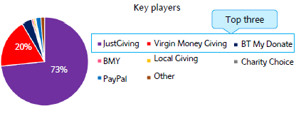



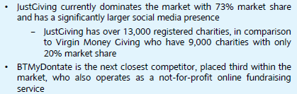

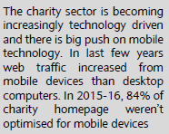
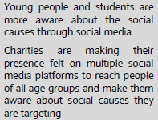


…The proposed fee structure is cheaper than the main three online fundraising competitors in the UK, making Barclays Roundup v2 a more attractive proposition for both charities and users:
Usage costs to charities
Fees taken from donations
Monthly subscription
£15 + VAT
(<£15K donations)
£39 + VAT
(>£15K donations)
JustGiving fee 5%
Card processing fee 1.25%
(or 1.45% Paypal)
Setup fee
£100 + VAT
Transaction fee 2%
Card processing fee 1.45%
(or 1.6% Paypal/Amex)
Free
Processing fee 13-15p
(debit/credit card)
v2
Free
Bstow fee 2.5%
(0.5% to Barclays)
The B2B solution also helps charities with two of the biggest barriers that prevent a greater volume of online donations:
v2

Slide 5



So…. Roundup V2.0 is a great product for clients, Barclays and the donors; everybody wins
Barclays Roundup v2 : Pilot Proposal
With the support of the Charities Team, we are looking to run the pilot with *name removed*– a partner that have actively sought to work with us on this proposition, one of the largest charities in the UK, and a target charity client. Funding of £50k is sought for dev work via Bstow.
Overview
WIN
Opportunity to integrate “do good” with everyday purchases and lifestyle
Enables customers to explore meaningful and impactful ways to spend spare change
More of the donated amount goes to the charity than current alternatives
Donors
+ SIF
Round Up v2
Clients
Barclays
WIN
Potential to raise £millions for good causes at scale
A cheaper, better product than current offerings on the market
WIN
18 month pay back period
31x revenue to costs ratio over first 3 years
Millennial engagement
Minimal operational costs
Partnering with *name removed* for pilot
£50k sought from SIF for development
Tangible returns for the SIF to reclaim £50k within 18 months and a % of the £1.1m p.a. revenue
Summary

Slide 6
Appendices Market Potential

Slide 7
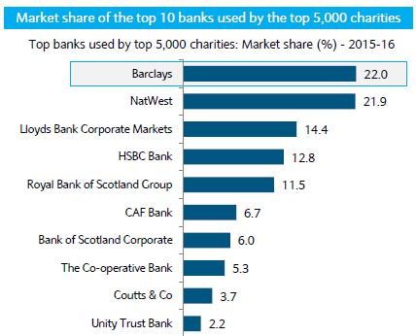
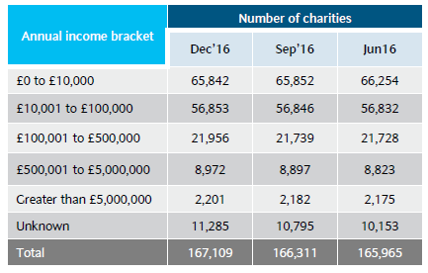


There is an excellent commercial opportunity given the scale of the UK market and appetite of the organisation to grow working with large charitable clients
As well as holding relationships with 22% of the Top 5,000 charities, Barclays is also the main banker to 32% of the Top 100 charities, and has relationships with 74% of this subsector.
Income growth expected to almost double

